Slide 1
Motivation
Humanistic & Psychoanalytic Perspective
Maslow’s Hierarchy
of
Needs

Slide 2
Read the following eight statements and choose those statements that apply to you. There are no right or wrong answers.
A. I am successful in life and/or work, and I’m recognized by my peers for being so. I’m satisfied with the responsibility and role that I have in life and/or work, my status and reputation, and my level of self-esteem.
B. I am part of, and loved by, my family. I have good relationships with my friends and colleagues - they accept me for who I am.

Slide 3
C. Above mostly everything else, I actively seek beauty, form and balance in things around me. My interest in beautiful culture and the arts is central to me.
D. My aim is self-knowledge and enlightenment. The most important thing to me is realizing my ultimate personal potential. I seek and welcome ‘peak’ experiences.
E. I generally feel safe and secure - job, home, etc - and protected from harm. My life generally has routine and structure - long periods of uncontrollable chaos are rare or non-existent.

Slide 4
F. The most important thing to me is helping others to reach their ultimate potential, whatever that may be, even at my own expense.
G. Aside from dieting and personal choice, I never starve through lack of food, nor lack of money to buy food. Aside from the usual trauma of moving house, I have no worry at all about having somewhere to live - I have ‘a roof over my head’.
H Improving my self-awareness is one of my top priorites. The pursuit of knowledge and meaning of things, other than is necessary for my work, is extremely important to me.

Slide 5
Motivation
Intensity of Drive/ Need
Direction
Persistence
Goal
INTRINSIC VS EXTRINSIC MOTIVATION

Slide 6
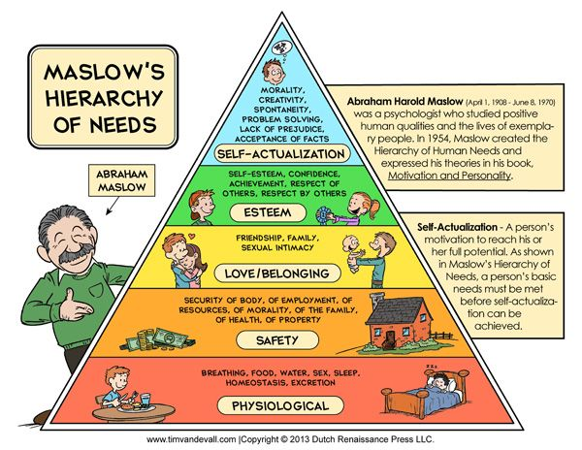

Slide 7


Slide 8
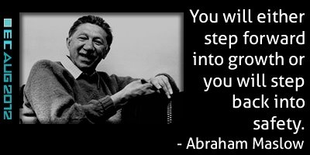

Slide 9
Interpretation:
A: Esteem Needs
B: Belongingness and Love Needs
C: Aesthetic Needs
D: Self-Actualisation Needs
E: Safety Needs
F: Transendence Needs
G: Biological Needs
H: Cognitive Needs

Slide 10
Maslow said that needs 1-4 are deficiency motivators and are generally satisfied in order when the previous need is fully or partially satisfied. If ticked above they are probably satisfied. If a need ceases to be satisfied there is less or no motivation to strive to maintain or satisfy higher level needs. Needs 5-8 are growth motivators. If ticked above they are likely to be a focus of personal growth motivation. This test is based on Maslow’s Hierarchy of Needs.

Slide 11
Psychoanalytic Perspective
Sigmund Freud
and
Defense Mechanism

Slide 12
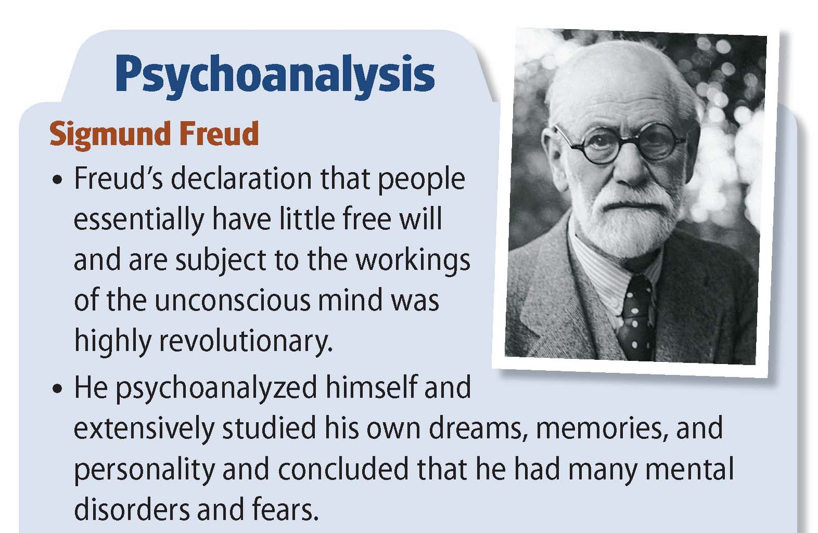

Slide 13
Sigmund Freud and Psychoanalysis
He theorized that the key to human behavior is satisfying desires.
Freud was the most famous of the early psychologists.
He developed psychoanalysis, which emphasizes unconscious motives and internal conflicts in human behavior.
He developed psychodynamic thinking, which assumes that most of what exists in an individual's mind is unconscious and consists of conflicting impulses, urges, and wishes.

Slide 14
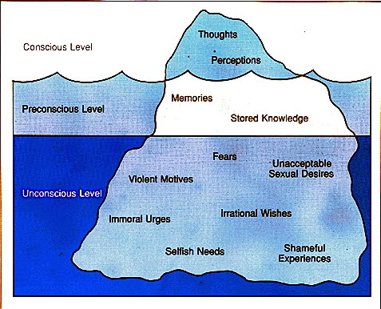
“Freud’s Iceberg”

Slide 15
Mind and Iceberg: Three levels of Mind
Conscious
Subconscious
Unconscious: “Safe heaven” for our recollection of threatening events

Slide 16
Structure of Personality:
ID
Pleasure Principle
EGO
Reality Principle (Executive of Personality)
Superego
Moral Principles

Slide 17
Anxiety & Defense Mechanism

Slide 18
Basic Concept
In Sigmund Freud's topographical model of personality, the ego is the aspect of personality that deals with reality.
While doing this, the ego also has to cope with the conflicting demands of the id and the superego.

Slide 19
The id seeks to fulfill all wants, needs, and impulses while the superego tries to get the ego to act in an idealistic and moral manner.
What happens when the ego cannot deal with the demands of ones desires, the constraints of reality, and ones own moral standards?
Anxiety acts as a signal to the ego that things are not going right.

Slide 20
Basic concepts
Freud identified three different types of anxiety.
Reality Anxiety: This is the most basic form of anxiety and is typically based on fears of real and possible events, such as being bitten by a dog or falling from a ladder.
The most common way of reducing tension from Reality Anxiety is taking oneself away from the situation !

Slide 21
Neurotic Anxiety: This is a form of anxiety which comes from an unconscious fear that the basic impulses of the ID (the primitive part of our personality) will take control of the person, leading to eventual punishment(this is thus a form of Moral Anxiety).
Id x Ego: Neurotic Anxiety
Moral Anxiety: This form of anxiety comes from a fear of violating values and moral codes, and appears as feelings of guilt or shame.
Superego x Ego: Moral Anxiety

Slide 22
According to Freud, anxiety is an unpleasant inner state that people seek to avoid.
When anxiety occurs, the mind first responds by an increase in problem-solving thinking, seeking rational ways of escaping the situation.
If this is not fruitful (and maybe anyway), ego has some tools it…, tools that help defend the ego… these are called Ego Defense Mechanisms or Defenses.
They helped shield the ego from the conflicts created by the id, superego, and reality.

Slide 23
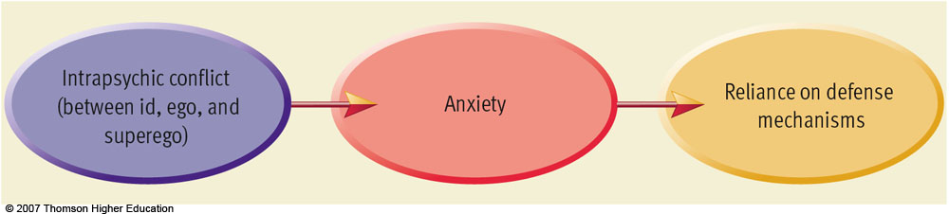

Slide 24
Denial: Arguing against an anxiety provoking stimuli by stating it doesn't exist.
Many people use denial in their everyday lives to avoid dealing with painful feelings or areas of their life they don’t wish to admit.
Examples:
1) Patient denies that his physician's diagnosis of cancer is correct and seeks a second opinion.
2) Alcoholics vigorously deny that they have a problem.
3) At school, a student seeing a grade of "C" next to their name, and automatically assuming the professor made a grading error.

Slide 25
Displacement: Taking out impulses on a less threatening target.
It occurs when the Id wants to do something of which the Super ego does not permit. The Ego thus finds some other way of releasing the psychic energy of the Id.
Thus there is a transfer of energy from a repressed object to a more acceptable object.

Slide 26
Displacements are often quite satisfactory and workable mechanisms for releasing energy more safely.
Examples:
1) The boss gets angry and shouts at a person. He goes home and shouts at his wife. She then shouts at their son. With nobody left to displace anger onto, he goes and kicks the dog.
2) A man wins the lottery. He turns to the person next to him and gives the person a big hug.

Slide 27
Rationalization: Supplying a logical or rational reason as opposed to the real reason.
When a person does something of which the moral super ego disapproves, then the ego seeks to defend itself by adding reasons that make the action acceptable to the super ego. Thus we are able to do something that is outside our values and get away with it without feeling too guilty.
Examples 1) A parent punishes a child and says that it is for the child's 'own good'.
2) A person evades paying taxes and then rationalizes it by talking about how the government wastes money (and how it is better for people to keep what they can).

Slide 28
Intellectualization: “Flight into reason”.
Thinking about events in cold, hard and rational terms
Intellectualization protects against anxiety by repressing the emotions connected with an event.
It is also known as 'Isolation of affect' as the affective elements are removed from the situation.
Intellectualization protects against anxiety by repressing the emotions connected with an event.
Example: a wife who learns her husband is dying tries to learn all she can about the disease, prognosis, treatment options. By doing this she can help repress the emotional onslaught of feelings of loss and anger which can accompany the death of a loved one.

Slide 29
Projection: Placing unacceptable impulses in yourself onto someone else.
Neurotic projection is perceiving others as operating in ways one unconsciously finds objectionable in yourself.
Complementary projection is assuming that others do, think and feel in the same way as you.

Slide 30
Reaction Formation: Taking the opposite belief because the true belief causes anxiety.
It appears as a defense against a feared social punishment.
A common pattern in Reaction Formation is for the person to show ‘excessive behavior’.
Psychoanalysts believe that extreme patterns of Reaction Formation are found in paranoia and obsessive-compulsive disorder (OCD), where the person becomes trapped in a cycle of repeating a behavior that they know (at least at a deep level) is somehow wrong.

Slide 31
Regression: Returning to a previous stage of development.
Examples:
1) A person who suffers a mental breakdown assumes a fetal position, rocking and crying.
2) Emotional Tantrum
3) A patient makes childish demands and becomes dependent on the nurse for care that they could do for themselves.

Slide 32
Repression: Pulling into the unconscious.
The level of 'forgetting' in repression can vary from a temporary abolition of uncomfortable thoughts to a high level of amnesia, where events that caused the anxiety are buried very deep.
A high level of repression can cause a high level of anxiety or dysfunction, although this may also be caused by the repression of one particularly traumatic incident.

Slide 33
Sublimation: acting out unacceptable impulses in a socially acceptable way.
Sublimation is probably the most useful and constructive of the defense mechanisms as it takes the energy of something that is potentially harmful and turns it to doing something good and useful.
sublimating your aggressive impulses toward a career such as, boxer

Slide 34
Examples –
A angry man does pushups to work off his temper.
A person who has an obsessive need for control and order becomes a successful business entrepreneur.
Becoming a surgeon because of your desire to cut; lifting weights to release 'pent up' energy

Slide 35
Acting Out: The individual deals with emotional conflict or internal or external stressors by actions rather than reflections or feelings.
When a person acts out, it can act as a pressure release, and often helps the individual feel calmer and peaceful once again.
For instance, a child’s temper tantrum is a form of acting out when he or she doesn’t get his or her way with a parent. Self-injury may also be a form of acting-out, expressing in physical pain what one cannot stand to feel emotionally.

Slide 36
Important Characteristics
Defenses are a major means of managing impulse and affect
Defenses are unconscious
Defenses are discrete from one another
Although often the hallmarks of major psychiatric syndromes, defenses are dynamic and reversible;
Defenses can be adaptive as well as pathological.

Slide 37
The ego’s protective methods of reducing anxiety.
Ego defenses are not necessarily unhealthy as one thinks.
In fact, the lack of these defenses, or the inability to use them effectively can often lead to problems in life.
However, we sometimes employ the defenses at the wrong time or overuse them, which can be equally destructive.

Slide 38
Purpose of Defense Mechanisms
Defenses allow individuals a period of respite to master changes in self-image that cannot be immediately integrated, as might result from puberty, an amputation, or a promotion (i.e., changes in reality).
Defenses can deflect or deny sudden increases in biological drives. Awareness of instinctual wishes is usually diminished; alternatively, antithetical wishes may be passionately adhered to.

Slide 39
Defenses enable individuals to mitigate unresolved conflicts with important people, living or dead.
Finally, ego mechanisms of defense can keep anxiety, shame, and guilt within bearable limits during sudden conflicts with conscience and culture.

Slide 40
Outcomes of Mature Defenses
Excellent adjustment as an adult,
Happiness,
Job satisfaction,
Rich friendships/ relationships,
Fewer medical hospitalizations over life,
Better overall health,
A lower incidence of mental illness.

Slide 41
Outcomes of Immature Defenses:
Poor adjustment as an adult,
Higher divorce rates and marital discord,
Poor friendship/ relationship patterns,
Higher incidence of mental illness,
Greater number of sick leave days taken,
Poorer health generally

